Slide 1
RELEASE GUIDELINES & WEBLOGIC SERVER BASICS

Slide 2
Weblogic Application Server
WebLogic Server is an application server: a platform for developing and deploying multitier distributed enterprise applications. WebLogic Server centralizes application services such as Web server functionality, business components, and access to backend enterprise systems.

Slide 3
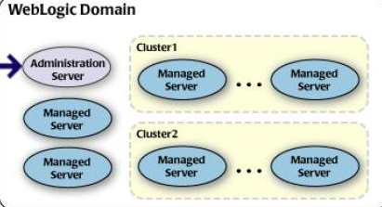
Weblogic-Architecture

Slide 4
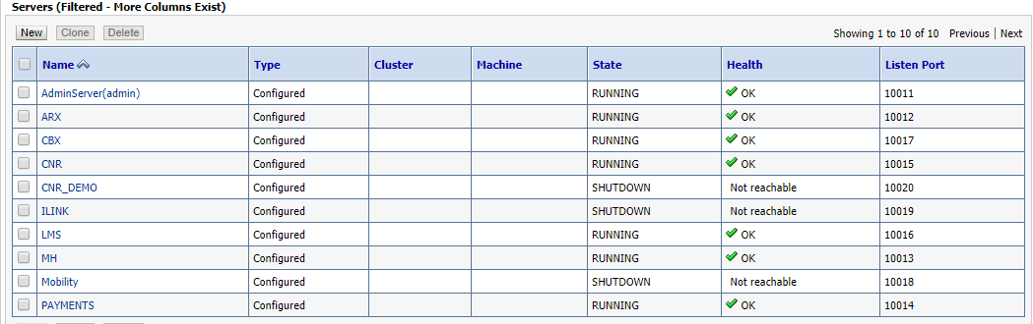
Example-Weblogic domain-BOB-SIT

Slide 5
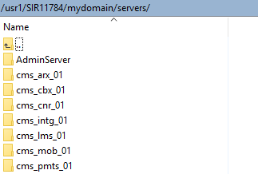
Weblogic domain

Slide 6
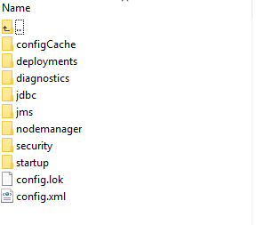
configuration

Slide 7
Java Message Service (JMS)
The Java Message Service (JMS) is a standard API for accessing enterprise messaging systems. Specifically, JMS:
Enables Java applications sharing a messaging system to exchange messages
Simplifies application development by providing a standard interface for creating, sending, and receiving messages

Slide 8
JMS Server
In the Weblogic Administration Console, expand Services > Messaging and select JMS Modules
JMS server defines a set of destinations such as queues, topics, and connection factories.
Manages connections and handles all message requests for its destinations
Act as management containers for the queues and topics in JMS modules that are targeted to them.

Slide 9
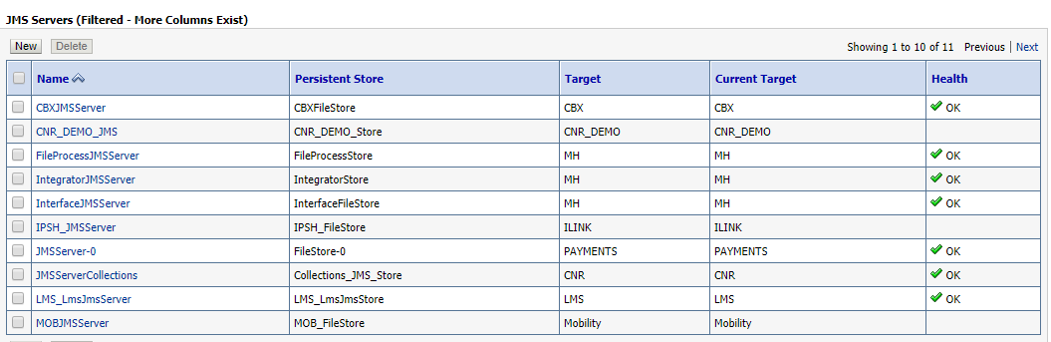
JMS-Servers-BOB-SIT

Slide 10
JMS Module
JMS modules contains configuration resources (such as queues, topics, and connections factories) and are defined by XML documents that conform to the weblogic-jms.

Slide 11
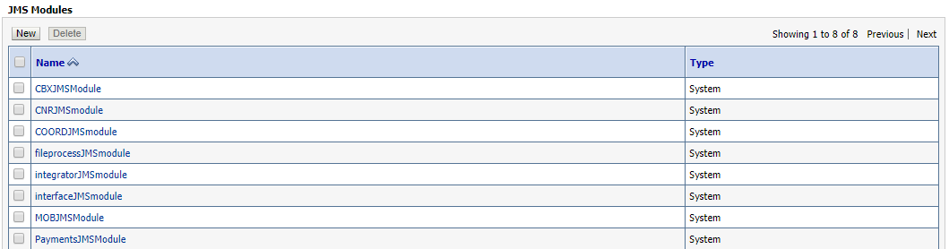
JMS-Modules

Slide 12
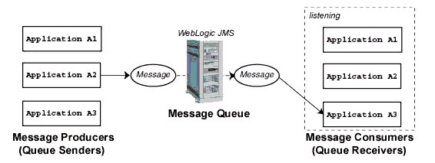
Point-to-Point Messaging

Slide 13
QUEUE
A JMS server defines a set of destinations (queues or topics) and any associated persistent storage that reside on a WebLogic Server instance. A JMS server manages connections and handles all message requests for its destinations on behalf of clients. Client applications.

Slide 14
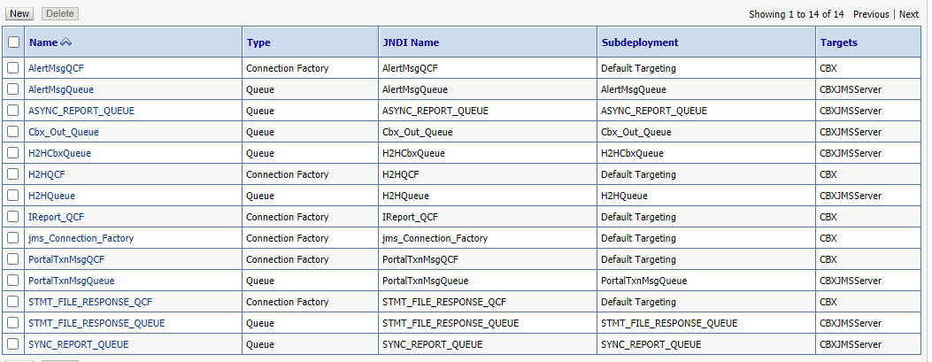
QUEUES & QCF

Slide 15
Release Request
1.Release request
Developers to raise release request on JIRA for QA approval for all the SIT releases with required artifacts,files and DIT evidence.
2.Issue / Change request Details :
Issue Description
RCA
Action Taken
Impact
Scope of Testing
Files Changed

Slide 16
Release Request contd..
3. Deployment steps / Instructions
Post QA approval, RMD team will deploy the release in SIT and confirm on JIRA.

Slide 17
Release Request contd..
There are two types releases.
Full Release
Incremental Release / Hot Fix
Full Release:
Full EAR / JAR files will be provided for deployment.
EAR,JAR,Properties ,DB scripts..etc will be uploaded in corresponding SIR folder and the same path will be mentioned in JIRA.
Ex: IP :172.16.3.218
USER NAME :VID15440
Path : /usr1/GTB_HOME/PYMNTS_HOME/payments/FCU/NACHFiles/IDFC_PHASE2_RELEASE/IDFC_SITPHASE2_RELEASE_H71/

Slide 18
Release Request contd..
Incremental Release / Hot Fix:
Particular changed class / jsp / property files / DB scripts will be provided for deployment.(To be attached in JIRA).

